Slide 1
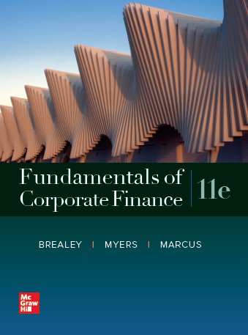
Fundamentals of Corporate Finance, 11th Edition
CHAPTER 5: The Time Value Of Money
© McGraw Hill LLC. All rights reserved. No reproduction or distribution without the prior written consent of McGraw Hill LLC.

Slide 2
Present Values
Present Value
Value today of a future cash flow
Discount Factor
Present value of a $1 future payment
Discount Rate
Interest rate used to compute present values of future cash flows
Notes:
31

Slide 3


Present Values
$\text{Present} \text{value}\text{ = }\text{PV}$
$$\text{PV}\text{ = }\frac{\text{Future} \text{value} \text{after} \text{t} \text{periods}}{\left(\text{1 + }\text{r}\right)\text{t}}$$
Notes:
32

Slide 4
Present Values
Discounted Cash Flow (DCF)
Method of calculating present value by discounting future cash flows
Future cash flow
Present value
Go to Excel
Notes:
34

Slide 5

Present Values
Example
You own a contract that will pay you $3,000 in two years. If you need cash today, you can sell the contract to another investor. If that investor needs 8% to justify the risks of waiting for payment, what should be the selling price of the contract? Excel
$\text{PV}\text{ = }\frac{\text{3,000}}{\left(\text{1.08}\right)\text{2}} \text{=}$ $2,572
Notes:
34

Slide 6
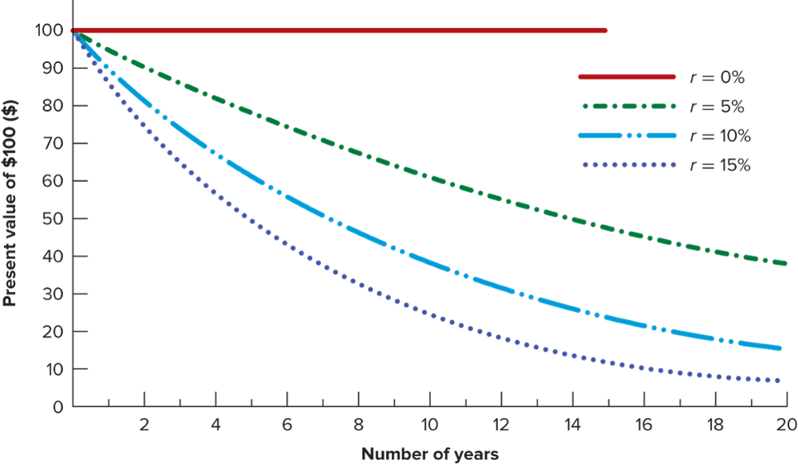
Present Values
Notes:
24

Slide 7
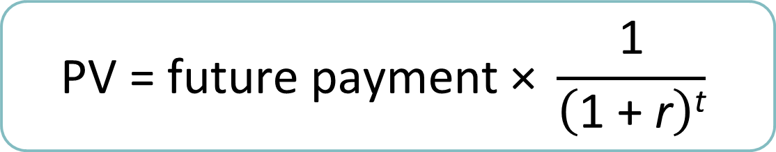
Time Value of Money (Applications)
The PV formula has many applications. Given any variables in the equation, you can solve for the remaining variable.
$$\text{PV}\text{ = }\text{future} \text{payment}\text{ × }\frac{\text{1}}{\left(\text{1 + }\text{r}\right)\text{t}}$$
Notes:
38

Slide 8
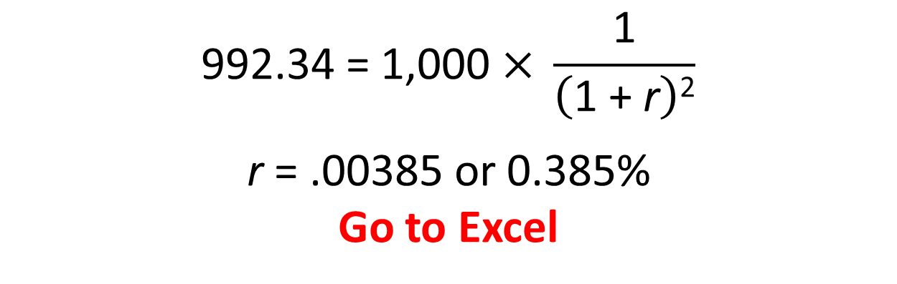
Time Value of Money (Applications)
Example
Italy borrowed money for 2 years, but it did not announce an interest rate. It simply offered to sell each IOU for €992.34. What is the interest rate?
$$\text{992.34 }\text{=}\text{ 1,000 }\text{×} \frac{\text{1}}{\left(\text{1 + }\text{r}\right)\text{2}}$$
$$\text{r} \text{=}\text{ .00385 }\text{or}\text{ 0.385\%}$$
Go to Excel
Notes:
38

Slide 9
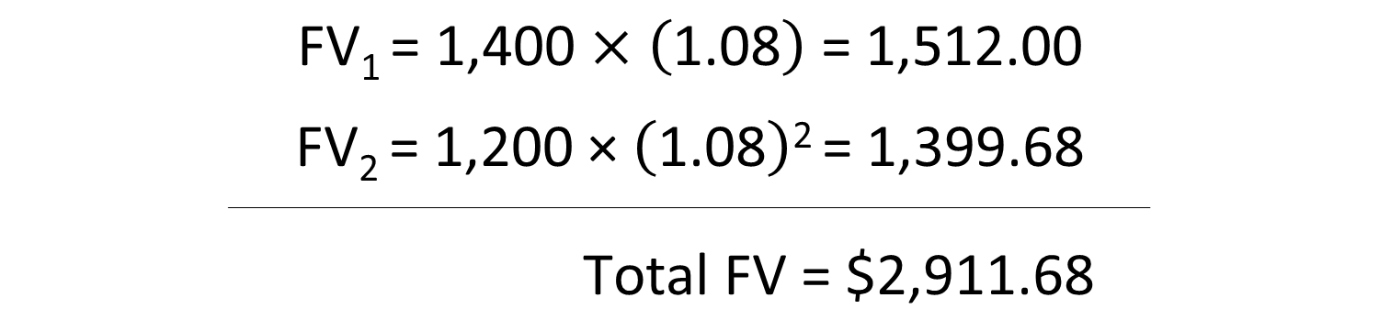
Future Value of Multiple Cash Flows
Example
You are able to put $1,200 in the bank now, and another $1,400 in 1 year. If you earn an 8% rate of interest, how much will you be able to spend on a computer in 2 years?
$$\text{FV}\text{1 }\text{=}\text{ 1,400 }\text{×} \left(\text{1}\text{.08}\right)\text{ = 1,512.00}$$
$$\text{F}\text{V}\text{2 }\text{=} \text{1,}\text{2}\text{00} \text{×} \left(\text{1.08}\right)\text{2 }\text{=} \text{1,}\text{399}\text{.}\text{68}$$
________________________________________________________________________________
$$\text{Total} \text{FV}\text{ = \$2,911.68}$$
Notes:
42

Slide 10
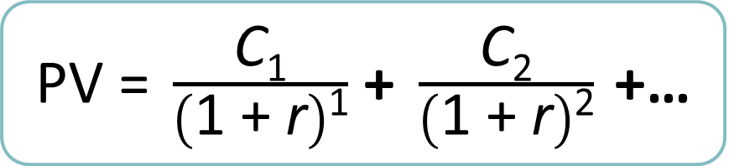
Present Value of Multiple Cash Flows (1 of 3)
PVs can be added together to evaluate multiple cash flows
$\text{PV}\text{ = }\frac{\text{C}\text{1}}{\left(\text{1 + }\text{r}\right)\text{1}}$ $\text{+ }\frac{\text{C}\text{2}}{\left(\text{1} \text{+} \text{r}\right)\text{2}} \text{+}$…
Notes:
43

Slide 11
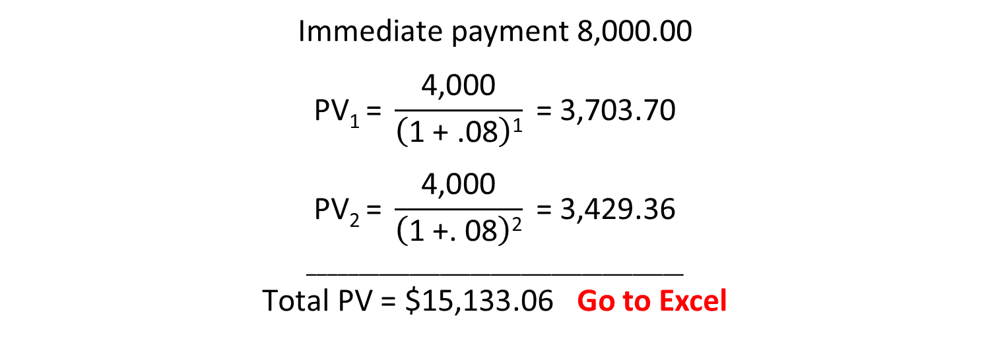
Present Value of Multiple Cash Flows (2 of 3)
Example
Your auto dealer gives you the choice to pay $15,500 cash now, or make three payments: $8,000 now and $4,000 at the end of the following two years. If your cost of money is 8%, which do you prefer?
$\text{Immediate}$ payment 8,000.00
$$\text{PV}\text{1 }\text{=} \frac{\text{4,000}}{\left(\text{1} \text{+} \text{.08}\right)\text{1}} \text{= 3,}\text{703}\text{.}\text{70}$$
$$\text{PV}\text{2 }\text{=} \frac{\text{4,000}}{\left(\text{1} \text{+.} \text{08}\right)\text{2}} \text{= 3,}\text{429}\text{.}\text{36}$$
_____________________________________
$\text{Total} \text{PV}\text{ = \$15,133.06}$ Go to Excel
Notes:
42

Slide 12
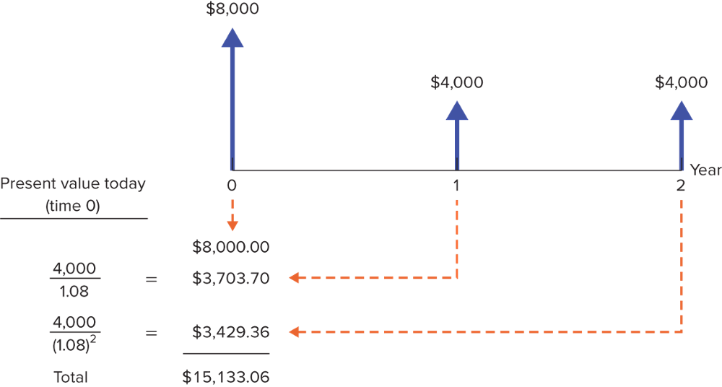
Present Value of Multiple Cash Flows (3 of 3)

Slide 13
Perpetuities and Annuities
Annuity
Level stream of cash flows at regular intervals with a finite maturity
Can use similar approach as you use for Cash Flow Stream
Can also use PMT (payment) function in Excel or calculator
Notes:
44

Slide 14
Calculations: Part 1 – Financial Calculators
Example
You need a 6.5% annual return to justify the risks of the following financial contract: you will receive annual payments of $50 for five years and one lump sum payment of $1,000 in five years. What price should you pay for the contract?
To get the final answer, use Excel to draw a timeline and determine the variables that you know. Because you know all variables EXCEPT the Present Value, use the PV function. (The minus sign in the solution indicates you will have a cash outflow to buy the contract; you are the investor.)
Notes:
51

Slide 15
End of first week F370
Homework #1 due no later than Friday at 5pm (end of business week)

